Slide 1
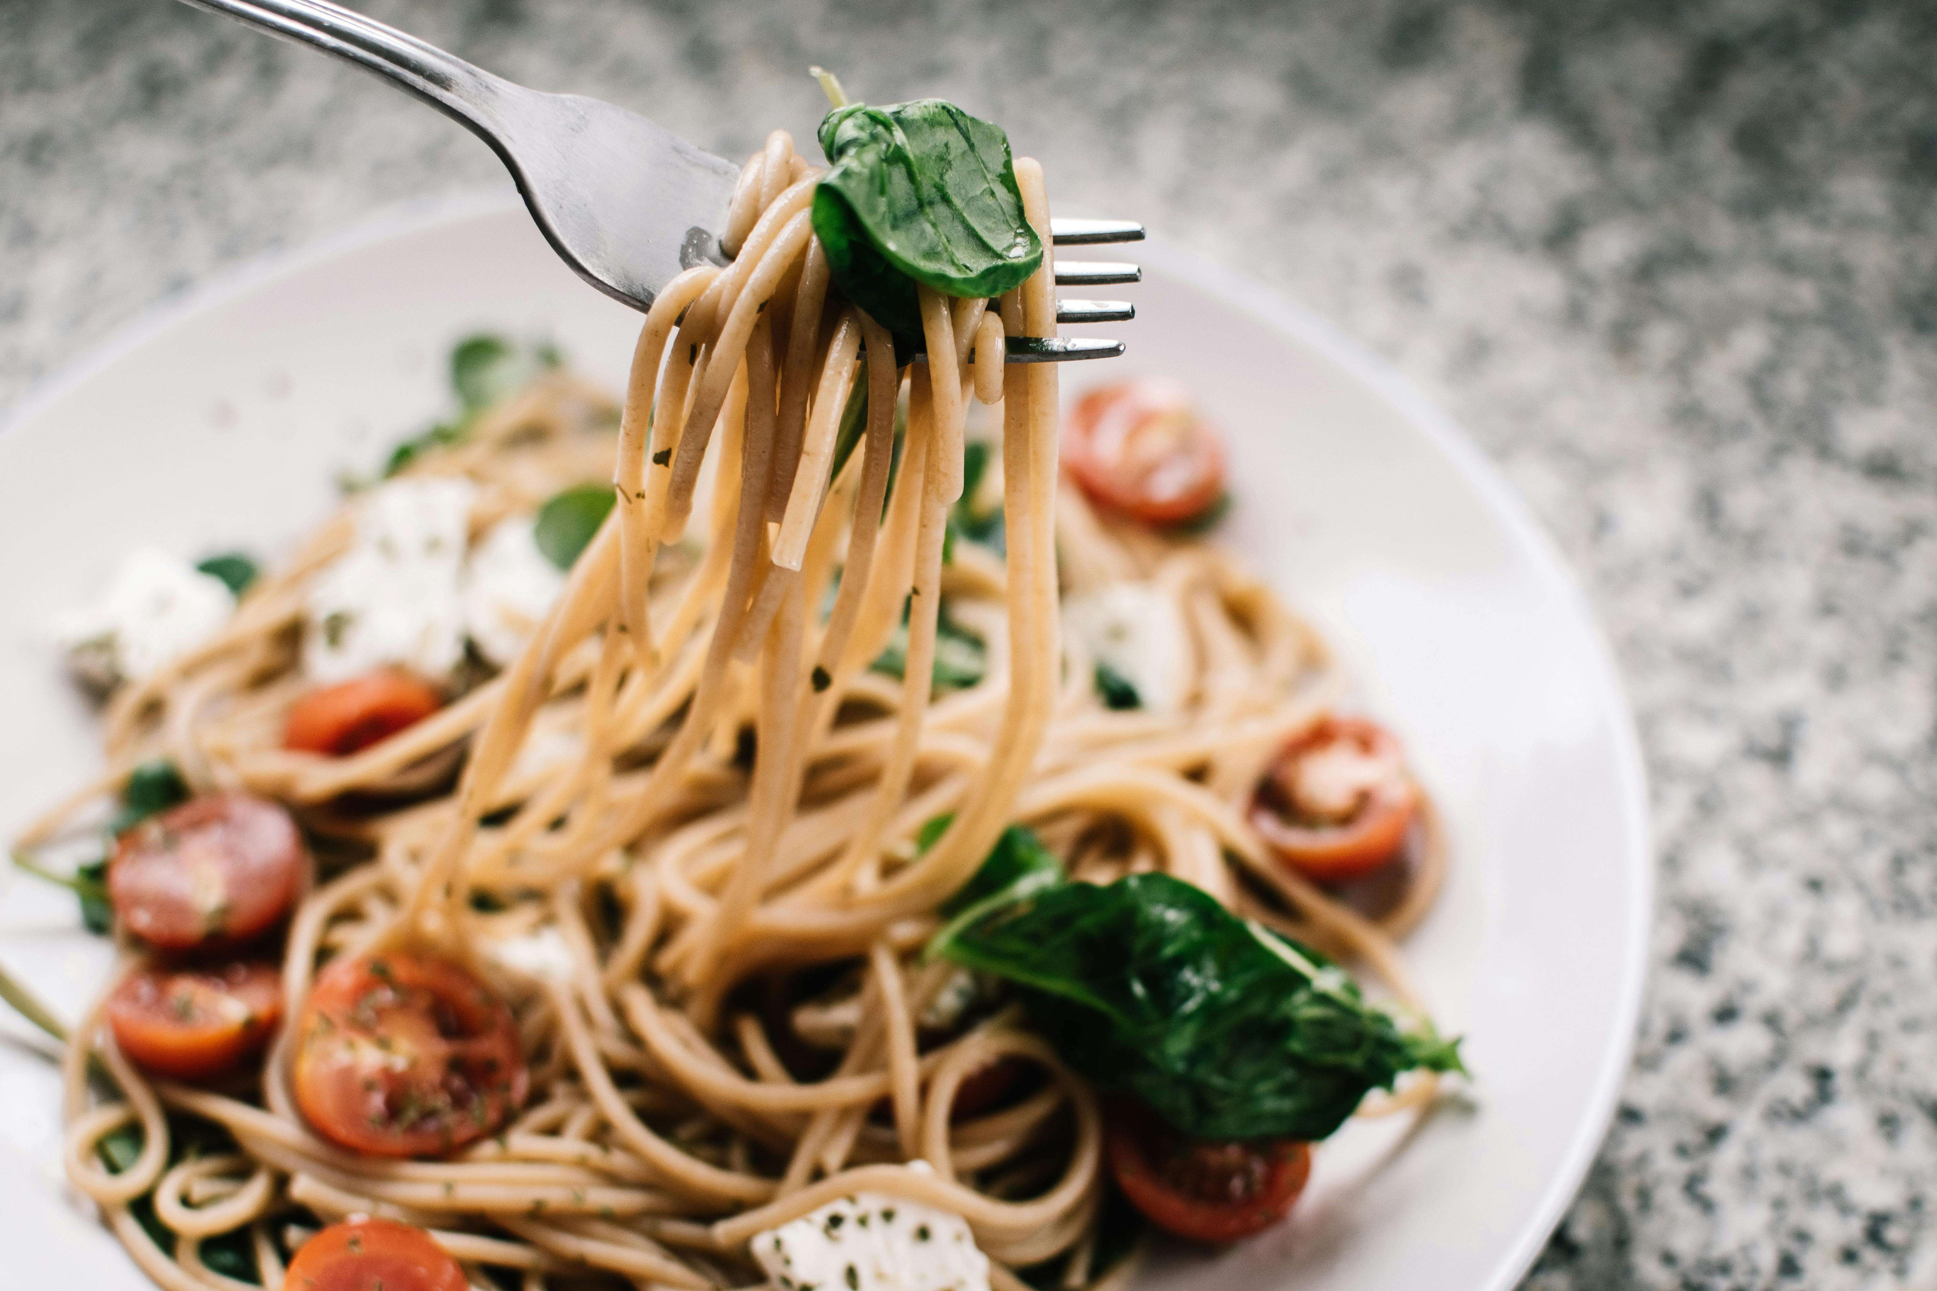
TEAM 03
CUSTOMER
TREND ANALYSIS BY FOOD BRANDS

Slide 2
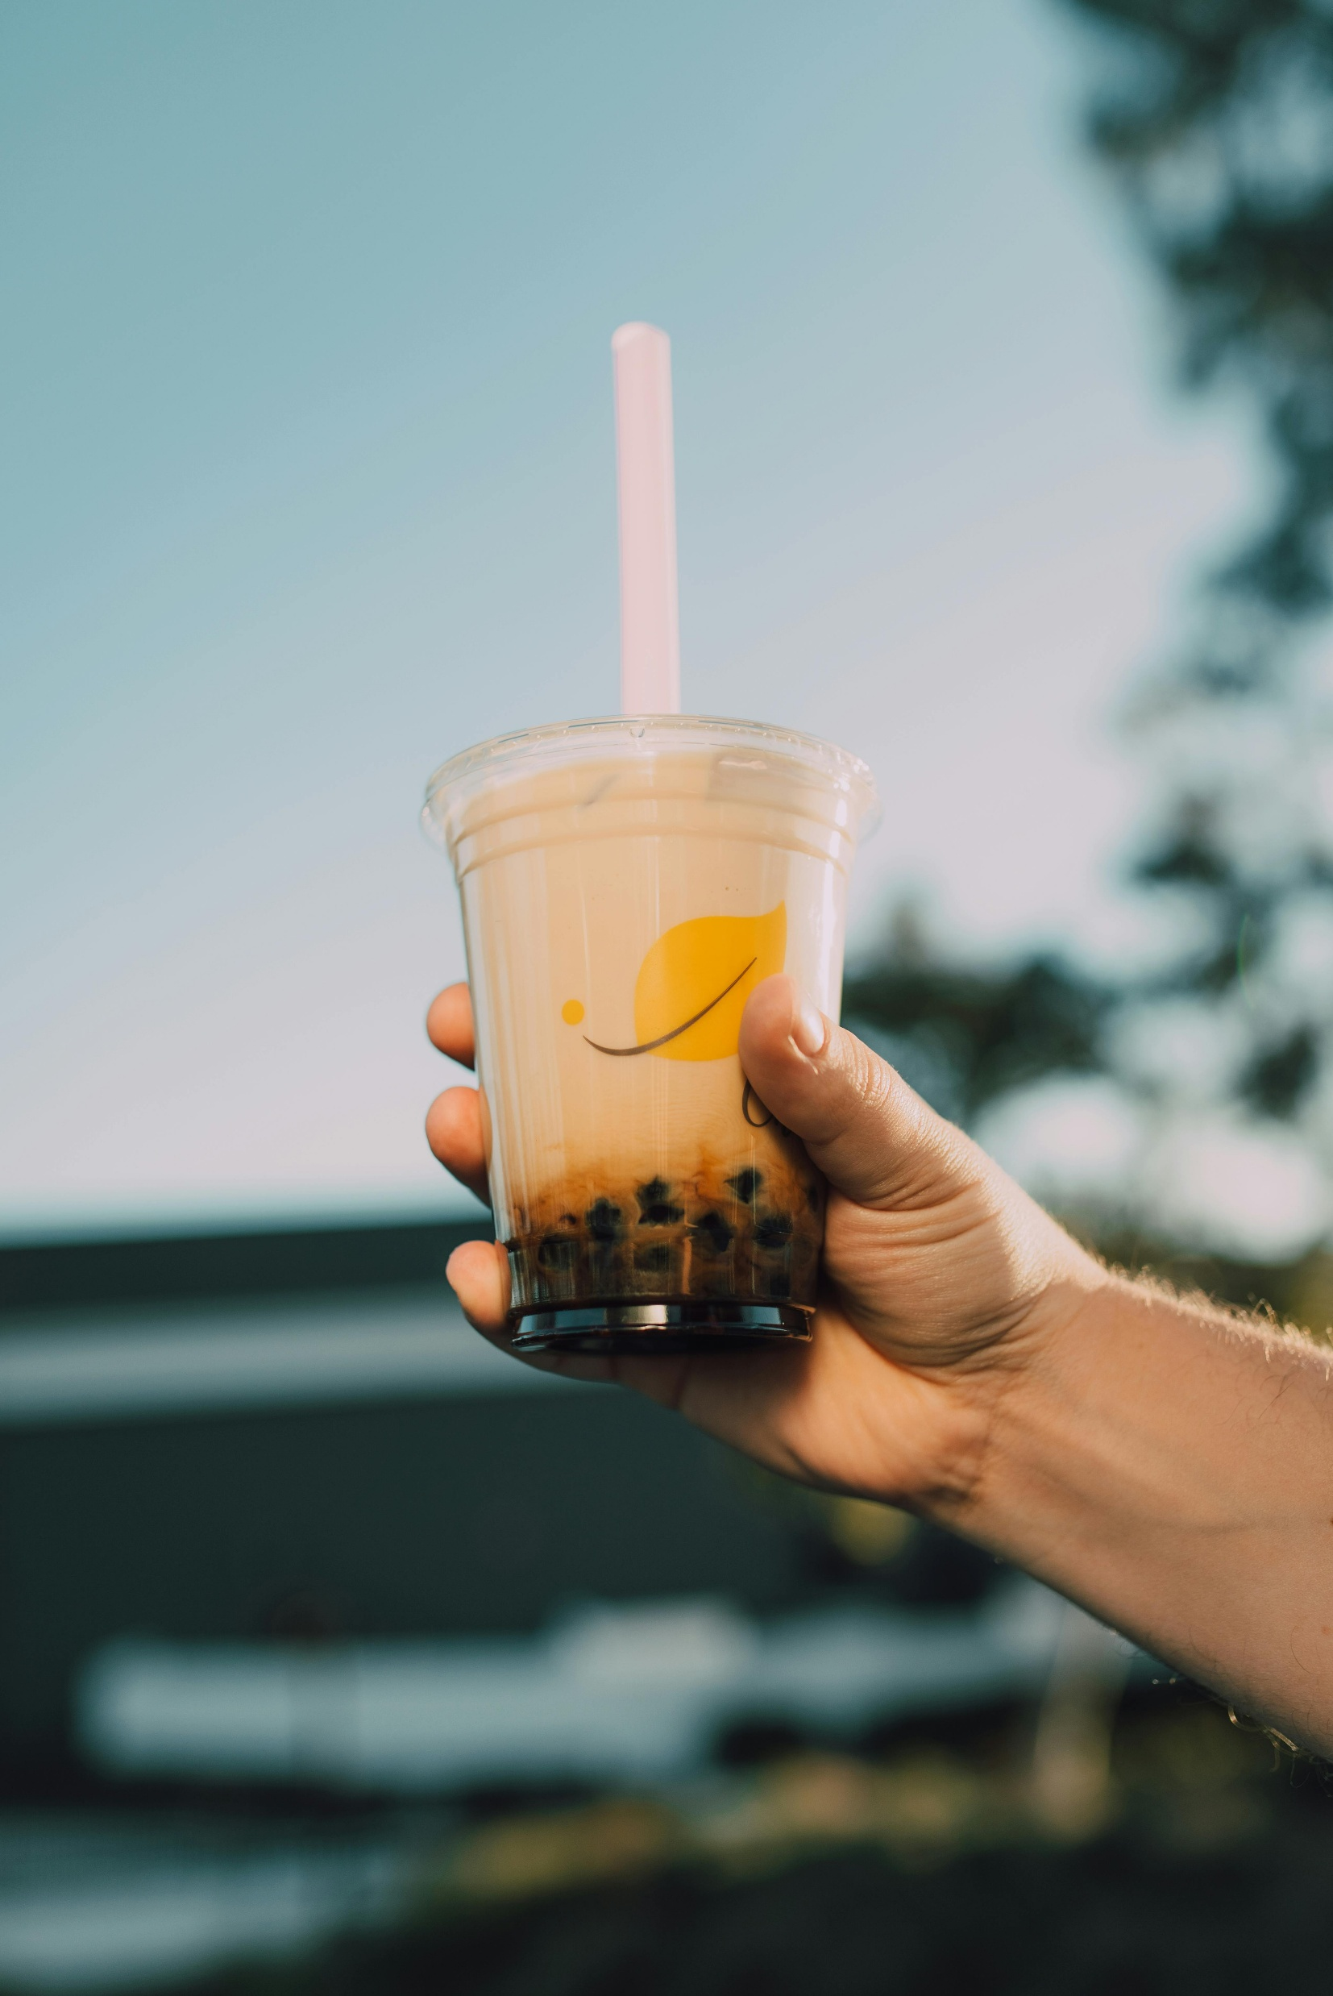

TEAM MEMBERS
1 . SAHELI BHATTACHARJEE
2 . SUBHASHINI R
3 . THEENUL FAREEHA M
4 . GADDAM VIVEKA VARDHAN
UNDER THE GUIDANCE OF MENTOR
PAVITHRA KANNAN

Slide 3






OBJECTIVE
01.INTRODUCTION
04.MILES STONES
This project leverages AI-driven sentiment analysis and Power BI to help food brands understand customer trends, preferences, and satisfaction through integrated feedback insights.
All milestones collectively ensured end-to-end development from data integration and sentiment analysis to customer segmentation and strategic insight generation for food brands..
02.PROJECT OVERVIEW
05.PROJECT SCREENSHOTS
A Power BI-based analytics project that integrates customer feedback from multiple sources to uncover sentiment patterns, preferences, and trends for data-driven decision-making in the food industry.
A Power BI-based analytics project that integrates customer feedback from multiple sources to uncover sentiment patterns, preferences, and trends for data-driven decision-making in the food industry.
03.KEY FEATURES
06.FUTURE ENHANCEMENT
Power BI dashboard that analyzes multi-source customer feedback to reveal sentiment, trends, and actionable insights for food brands.
Future enhancements include integrating real-time social media analytics and predictive modeling to forecast emerging customer trends.

Slide 4
INTRODUCTION
The project ‘Food Brand – Understand Customer Trends’ aims to help food companies gain a deep understanding of their customers’ opinions, preferences, and satisfaction levels by analyzing feedback from multiple sources such as surveys, social media platforms, and online product reviews. By leveraging AI-powered sentiment analysis and Power BI visualizations, the project transforms raw data into meaningful insights that reveal positive and negative sentiments, recurring complaints, and emerging preferences. It further segments customers based on behavioral patterns, purchase frequency, and regional trends, offering a holistic view of customer engagement. This data-driven approach not only assists product development and marketing teams in making informed decisions but also supports innovation, enhances customer experience, and strengthens brand loyalty through continuous feedback monitoring and trend analysis..

Slide 5


PROJECT OVERVIEW
The project ‘Food Brand – Understand Customer Trends’ focuses on analyzing customer feedback data collected from multiple sources such as surveys, social media, and online reviews to uncover insights into consumer sentiment and preferences. Using AI-driven sentiment analysis integrated with Power BI, the project visualizes patterns such as positive, negative, and neutral feedback across various food products, locations, and time periods. The dashboards provide a comprehensive view of customer satisfaction, review frequency, and sentiment distribution by category and region. Upcoming modules will include detailed product performance analysis and insights into the most preferred food categories, enabling food brands to make data-backed decisions for improving product quality, marketing strategies, and overall customer experience.

Slide 6
KEY FEATURES
1. Customer Sentiment Visualization
Displays the overall distribution of customer feedback into positive, negative, and neutral sentiments using donut charts.
Helps quickly identify the proportion of satisfied vs dissatisfied customers.
5. Location-Based Sentiment Map
An interactive geographical map displays review distribution and sentiment category by city or region (e.g., Mumbai, Delhi, Kochi).
Enables detection of regional preferences or issues, allowing for targeted marketing.
2. Sentiment Trend Over Time
Line charts show how customer sentiment changes month by month or year by year.
Useful for tracking how product perception evolves after campaigns or new product launches.
6. Customer Feedback Table
A detailed data table listing product names, customer feedback, and sentiment classification.
Provides transparency and allows for drill-down analysis of individual comments.
3. Product-Wise Sentiment Breakdown
Bar and stacked column charts compare different food products (e.g., Chicken Pizza, Cold Coffee, Chocolate Cake) by sentiment.
Clearly indicates which products are most loved or most criticized based on customer feedback.
8. Filters and Drill-Down Options
Interactive filters for location, product name, and source (survey, social media, review site).
Enables dynamic analysis and focused exploration of specific data subsets.

Slide 7
MILESSTONES
Milestone 1 – Data Collection & Cleaning
Milestone 3 – Product Performance
Collected feedback from surveys, social media, and reviews; cleaned, standardized, and merged into a unified dataset with consistent keys for analysis.
Clustered users into groups like Loyal Fans, Critics, and Silent Users based on sentiment patterns, activity level, and preferences.
Milestone 2 – Sentiment Analysis Implementation
Milestone 4 – Strategy and Trend
Built strategy dashboards highlighting trending keywords, sentiment shifts, and actionable insights for marketing and product improvement.
Collected feedback from surveys, social media, and reviews; cleaned, standardized, and merged into a unified dataset with consistent keys for analysis.

Slide 8
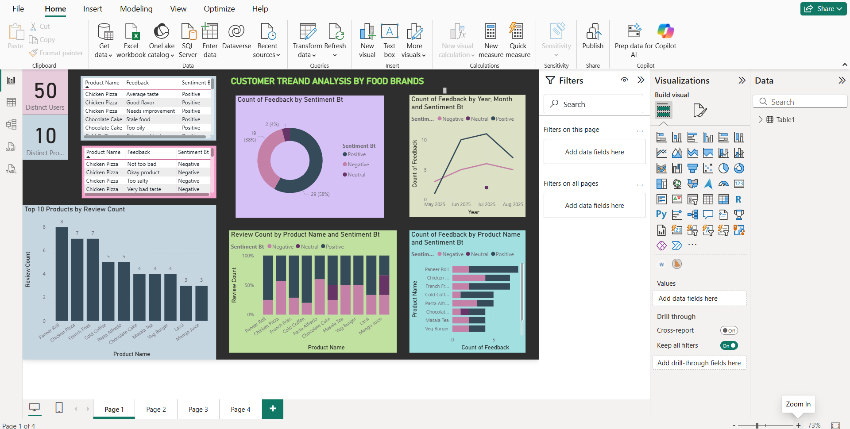
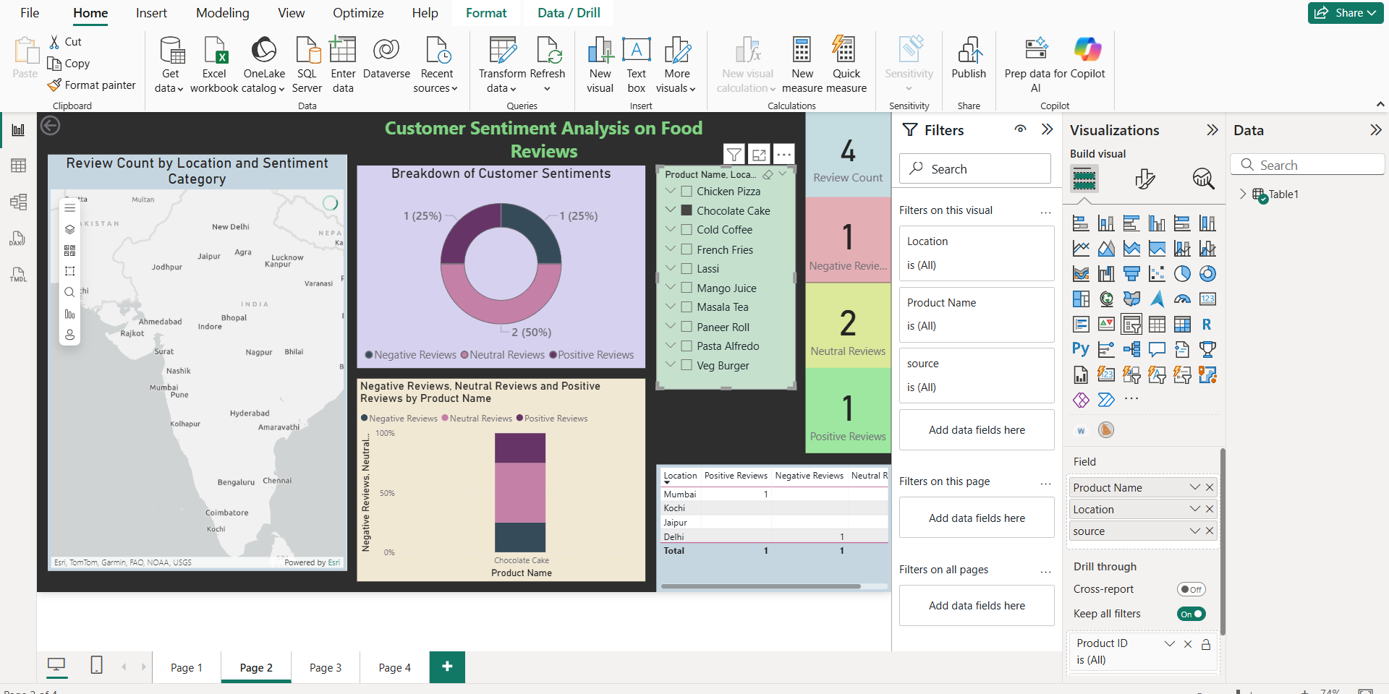
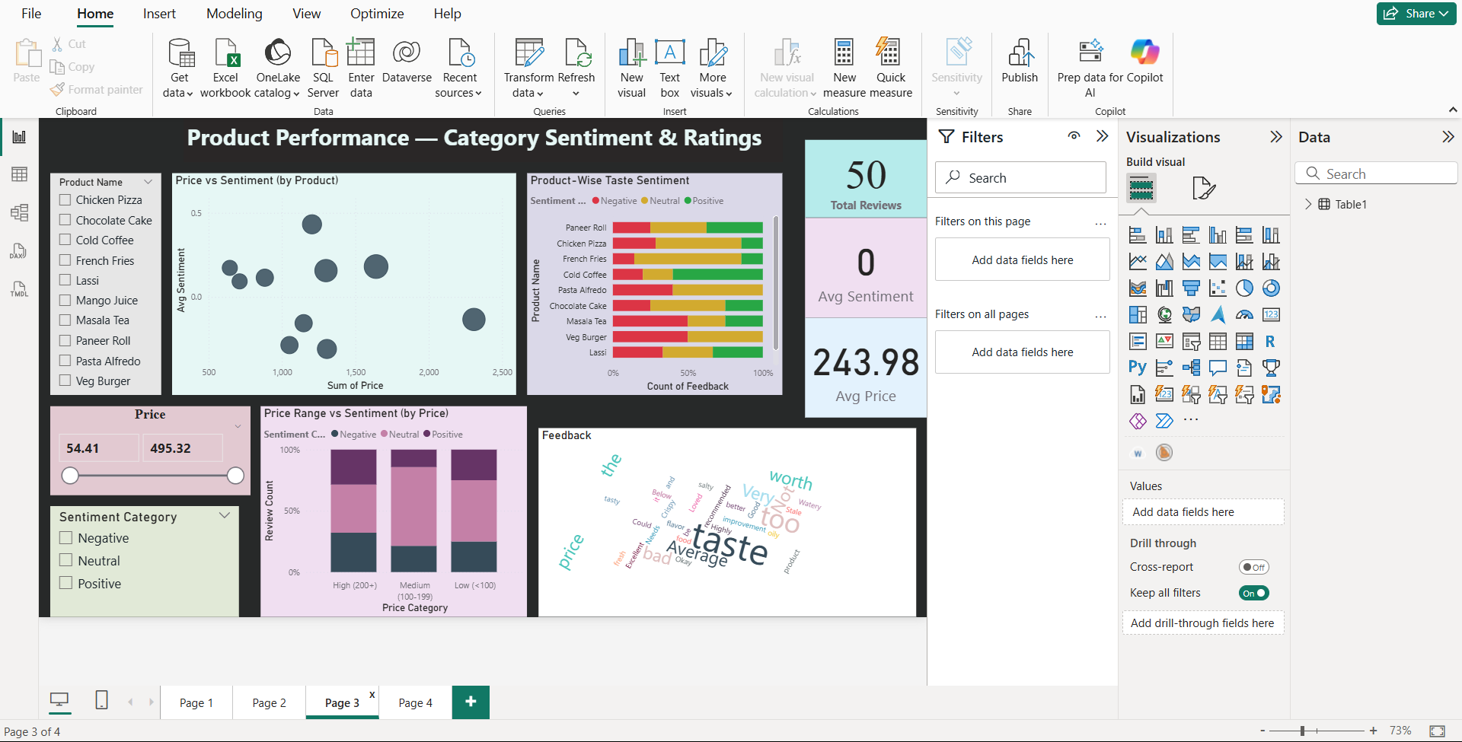
PROJECT SCREENSHOTS

Slide 9
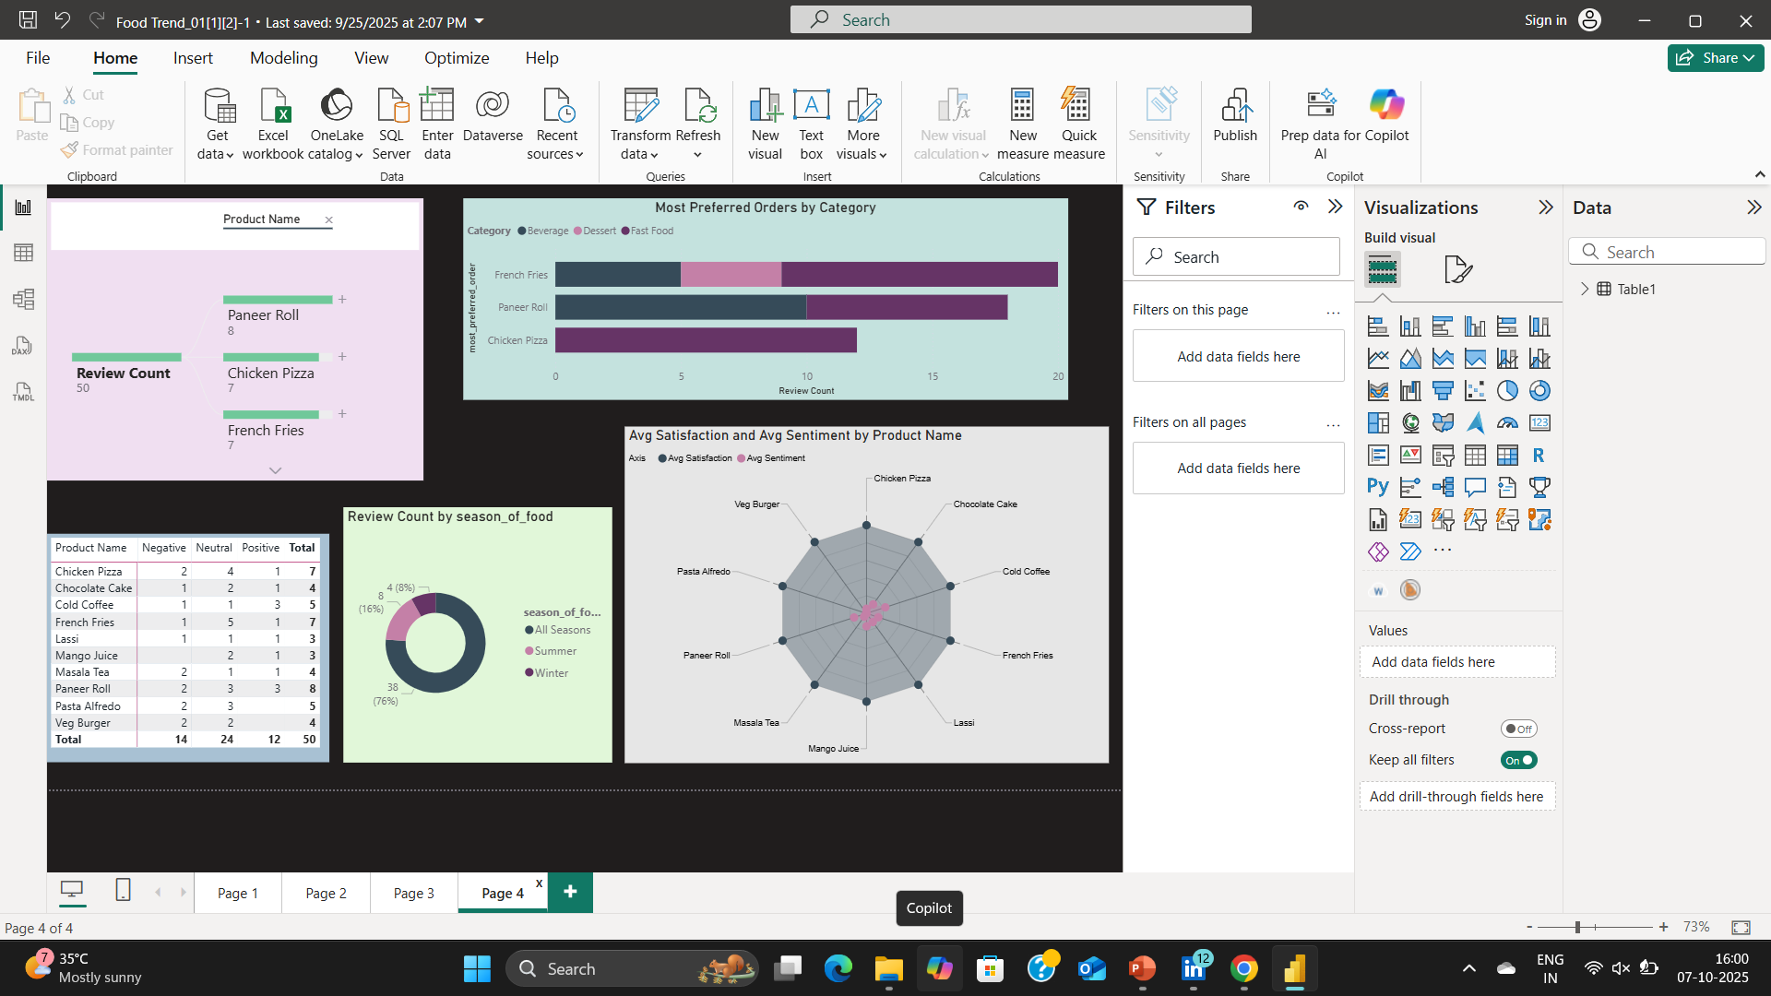
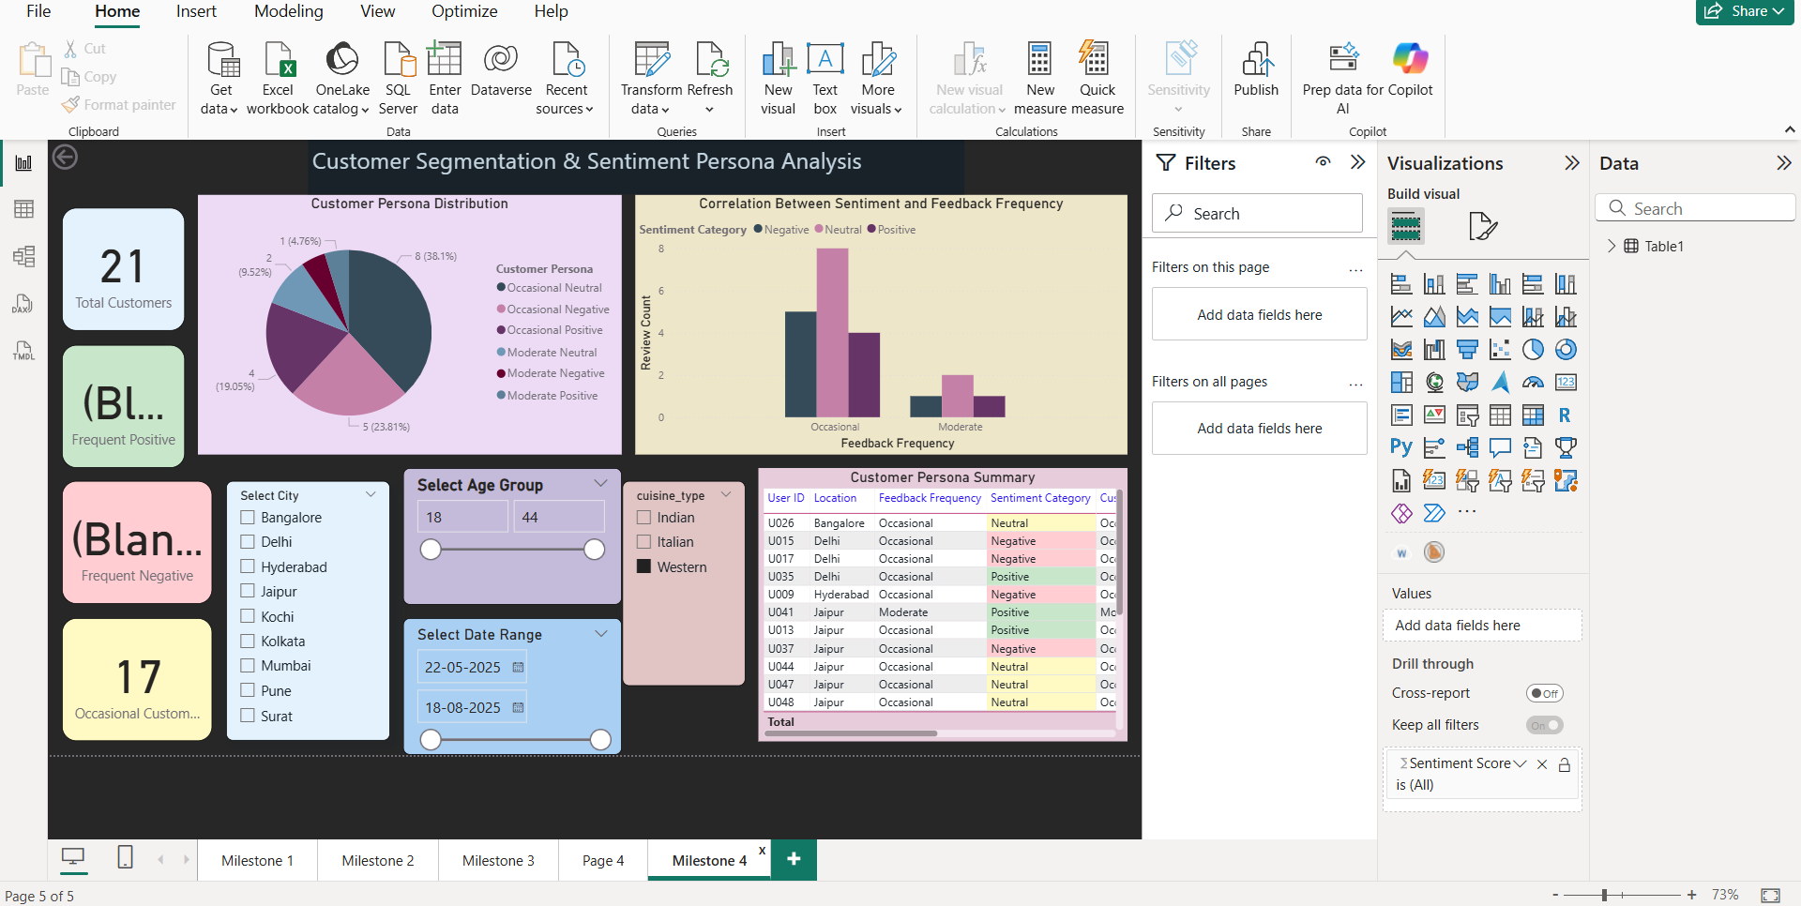
SCREENSHOTS MILESSTONE 4

Slide 10
FUTURE ENHANCEMENT
In the future, this project can be extended to include real-time data integration from social media platforms and review sites to continuously monitor customer sentiment as it evolves. Incorporating predictive analytics and machine learning models will enable the system to forecast emerging customer preferences, detect potential product issues early, and suggest improvement strategies proactively. The dashboards can be enhanced with interactive storytelling visuals, AI-driven recommendations, and automated alerts for sudden sentiment changes. Additionally, linking the system with sales and supply chain data can provide a complete view of how customer opinions directly impact business performance. These advancements will make the solution more dynamic, intelligent, and valuable for data-driven decision-making in the food industry.

Slide 11
Turning customer voices into data-driven insights for smarter food brand decisions
WE WELCOME YOUR QUERIES AND FEEDBACK

